Slide 1

NLP course 2021
Homework 2
Aspect-Based Sentiment Analysis
Prof. Roberto Navigli
Teaching assistants:
Cesare Campagnano
Pere-Lluís Huguet Cabot

Slide 2
Aspect-Based Sentiment Analysis
A gentle introduction
Homework 2 - Aspect-Based Sentiment Analysis

Slide 3
Aspect-Based Sentiment Analysis (ABSA)
Homework 2 - Aspect-Based Sentiment Analysis
ABSA aims to identify the aspect terms of given target entities (in our case restaurants and laptops) and the sentiment expressed towards each aspect.
It is usually consists of the following subtasks:
aspect term identification → a
aspect term polarity classification → b
aspect category identification → c
aspect category polarity classification → d
For the sake of simplicity, let’s call them a, b, c and d

Slide 4
ABSA: aspect term identif. + classif. (a + b)
Homework 2 - Aspect-Based Sentiment Analysis
Input: I love their pasta but I hate their Ananas Pizza.
Output: {(pasta, positive); (Ananas Pizza, negative)}
Multi-word aspect terms should be treated as single terms!

Slide 5
Examples
Homework 2 - Aspect-Based Sentiment Analysis
Input: Ananas Pizza was great to see, but not to taste!
Output: {(Ananas Pizza, conflict)}
Used when there is more than one contrasting polarity

Slide 6
Examples
Homework 2 - Aspect-Based Sentiment Analysis
Input: I will come back for sure!
Output: {}
There can be samples with no aspect terms at all!

Slide 7
ABSA: aspect category identif. + classif. (c + d)
Homework 2 - Aspect-Based Sentiment Analysis
Input: The people there is so kind and the taste is exceptional
Output: {(staff, positive); (food, positive)}

Slide 8
The homework
Aspect-Based Sentiment Analysis
Homework 2 - Aspect-Based Sentiment Analysis

Slide 9
The homework
Homework 2 - Aspect-Based Sentiment Analysis
aspect term identification
aspect term polarity classification
aspect category identification
aspect category polarity classification
Mandatory
Extra!

Slide 10
Multi-step model
Homework 2 - Aspect-Based Sentiment Analysis
Mandatory (a + b)
Subtasks a (aspect term identification) and b (aspect term polarity classification) are mandatory and will be evaluated separately, i.e. both will be scored and must surpass a (very low) baseline to pass.
Instead, the overall score (a + b) will be computed on both and it will count for the quantitative evaluation (see evaluation slide, page X)
Extra (c + d)
Subtasks c (aspect category identification) and d (aspect category polarity classification) have no constraints, will not count on the quantitative evaluation but towards the extra points and must surpass a (medium) baseline to be considered as extra.

Slide 11
Multi-step model
Homework 2 - Aspect-Based Sentiment Analysis
Example (subtask a): given a sentence, identify the aspect terms
I hate their pasta but I love their pizza
model a
{pasta, pizza}
Hint: check out the notebook #6 (in particular, the NER part!)

Slide 12
Multi-step model
Homework 2 - Aspect-Based Sentiment Analysis
Example (subtask b):
given a sentence and an aspect term, identify the polarity towards the aspect term
I hate their pasta but I love their pizza
model b
negative
I hate their pasta but I love their pizza
model b
positive
Hint 1: you should indicate where the target word is in the sentence. There are many ways to do this, either a simple 0/1 flag, a trainable flag embedding, special tokens, etc. Be creative!
Hint 2: the formulation is similar to WiC, you could start from your WiC architecture!

Slide 13
Modeling ABSA
Homework 2 - Aspect-Based Sentiment Analysis

Slide 14
Modeling ABSA
Homework 2 - Aspect-Based Sentiment Analysis
{(pasta, negative); (pizza, positive)}
Model b
(LSTM, Transformer, etc.)
Note: It is not mandatory that a and b are two different models! But the two steps must be able to be evaluated separately!
Model a
(LSTM, Transformer, etc.)
I
hate
their
pasta
but
I
love
their
pizza

Slide 15
ABSA: evaluation (model_ab)
Homework 2 - Aspect-Based Sentiment Analysis
The performance of a ABSA system is usually measured in terms of Macro F1.
"I love their pasta but I hate their Ananas Pizza."
Even if aspect is correct!
Gold Term: | pasta | Ananas Pizza | Pred Term: | Ananas Pizza | their | pasta
Gold Sentiment: | positive | negative | Pred Sentiment: | negative | positive | neutral
True positive
Precision = 100 * tp / (tp + fp) = 100* 1/ (1+2) = 33.33%
Recall = 100 * tp / (tp + fn) = 100* 1/ (1+1) = 50%
F1 = 2 * precision * recall / (precision + recall) = 39,6%
False positive
False negative

Slide 16
ABSA: evaluation
Homework 2 - Aspect-Based Sentiment Analysis
For model b evaluation is the same but aspects are given.
"I love their pasta but I hate their Ananas Pizza."
Gold Term: | pasta | Ananas Pizza | Pred Term: | Ananas Pizza | their | pasta
Gold Sentiment: | positive | negative | Pred Sentiment: | negative | positive | neutral
True positive
Precision = 100 * tp / (tp + fp) = 100* 1/ (1+2) = 50%
Recall = 100 * tp / (tp + fn) = 100* 1/ (1+1) = 50%
F1 = 2 * precision * recall / (precision + recall) = 50%
False positive
False negative

Slide 17
ABSA: evaluation
Homework 2 - Aspect-Based Sentiment Analysis
Model c + d evaluation is the same as model a + b, but for a given set of categories.
For model a + b and model c + d the performances per sentiment and category will be given.
Performance for aspect extraction will be computed from model a + b (non aspect words do not count and only exact matches are considered).
Output will give Precision, Recall and F1, as well as True Positives, False Negatives and False Positives.

Slide 18
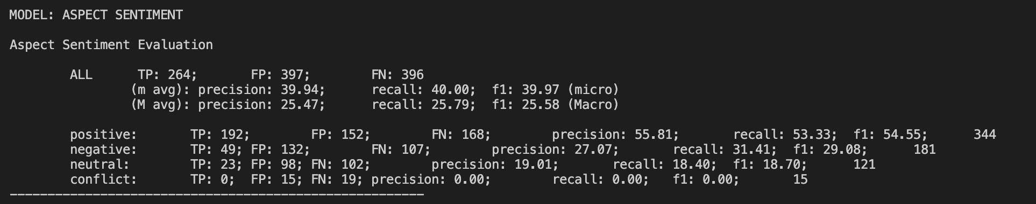
ABSA: evaluation
Homework 2 - Aspect-Based Sentiment Analysis
Example for model b (with a Random baseline):

Slide 19
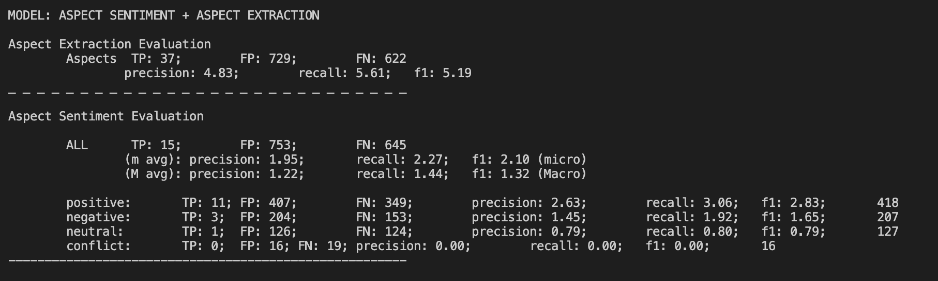
ABSA: evaluation
Homework 2 - Aspect-Based Sentiment Analysis
Example for model a + b (with a Random baseline):

Slide 20
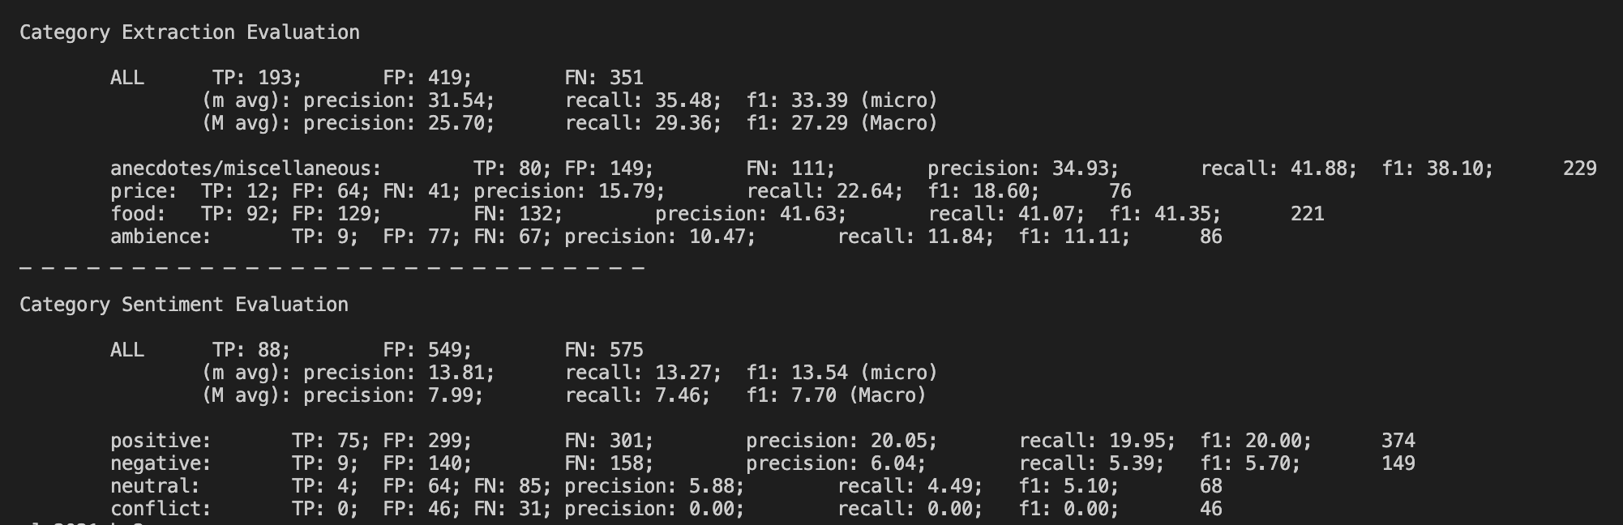
ABSA: evaluation
Homework 2 - Aspect-Based Sentiment Analysis
Example for model c + d (with a Random baseline):

Slide 21
Submission
What you will receive & How to submit
Homework 2 - Aspect-Based Sentiment Analysis

Slide 22
What you will receive: data format
Homework 2 - Aspect-Based Sentiment Analysis
The dataset is a JSON file where each entry contains the following fields:
{
"text": "I love their pasta but I hate their Ananas Pizza.",
"targets": [
[13, 17], "pasta", "positive"],
[[36, 47], "Ananas Pizza", "negative"]
],
"categories": [
("food", "conflict")
],
}
Input sentence

Slide 23
What you will receive: data format
Homework 2 - Aspect-Based Sentiment Analysis
The dataset is a JSON file where each entry contains the following fields:
{
"text": "I love their pasta but I hate their Ananas Pizza.",
"targets": [
[13, 17], "pasta", "positive"],
[[36, 47], "Ananas Pizza", "negative"]
],
"categories": [
("food", "conflict")
],
}
Target aspects (there may be 0 or more)

Slide 24
What you will receive: data format
Homework 2 - Aspect-Based Sentiment Analysis
The dataset is a JSON file where each entry contains the following fields:
{
"text": "I love their pasta but I hate their Ananas Pizza.",
"targets": [
[13, 17], "pasta", "positive"],
[[36, 47], "Ananas Pizza", "negative"]
],
"categories": [
("food", "conflict")
],
}
[boundaries, surface form, sentiment]

Slide 25
What you will receive: data format
Homework 2 - Aspect-Based Sentiment Analysis
The dataset is a JSON file where each entry contains the following fields:
{
"text": "I love their pasta but I hate their Ananas Pizza.",
"targets": [
[13, 17], "pasta", "positive"],
[[36, 47], "Ananas Pizza", "negative"]
],
"categories": [
("food", "conflict")
],
}
Categories data, only for restaurants data for the extra task

Slide 26
What you will receive: data format
Homework 2 - Aspect-Based Sentiment Analysis
The dataset is a JSON file where each entry contains the following fields:
{
"text": "I love their pasta but I hate their Ananas Pizza.",
"targets": [
[13, 17], "pasta", "positive"],
[[36, 47], "Ananas Pizza", "negative"]
],
"categories": [
("food", "conflict")
],
}
Target categories (there may be 1 or more)

Slide 27
What you will receive: files
Homework 2 - Aspect-Based Sentiment Analysis
We will provide you a folder with the following structure:
nlp2021-hw2/
data/
hw2/
model.py
simple_test.py
stud/
model/
requirements.txt
test.sh
You are allowed to edit only the items in bold.
We will use Docker for evaluation. As far as you do not change any file but those we marked in bold, if test.sh runs on your side, it will run on ours as well. Find the code repository here. You can use simple_test.py to test your predict functions.

Slide 28
What you will receive: datasets
Homework 2 - Aspect-Based Sentiment Analysis
In the data/ folder you will find two datasets:
restaurants,
laptops
with the same annotation scheme.
Keep in mind that only restaurants is annotated for tasks c + d, so the evaluation will be performed using just restaurants data.
i.e. if you use just one model for a + b + c + d, make sure not to backpropagate laptops data for task c + d or it may affect performance. Both datasets should be used to train model b and a + b and will be evaluated jointly.

Slide 29
What we expect from you
Homework 2 - Aspect-Based Sentiment Analysis
The zip folder we gave you (but populated :))
Put your training code (if you used Colab, download the notebook .ipynb and place it) in hw2/stud/
If you use any additional library, modify the requirements.txt file as needed (click here for info)
Use the data (train, dev and test) in the data folder; use each file as defined in the standard ML conventions (train for training, dev for model selection, …)
Put everything your model needs (vocabulary, weights, …) inside the model/ folder, and be sure to properly load them in your model

Slide 30
What we expect from you
Homework 2 - Aspect-Based Sentiment Analysis
In hw2/stud/implementation.py implement the StudentModel class
Load your model and use it in the predict method
You must respect the signature of the predict method
You can add other methods (i.e. the constructor)
In hw2/stud/implementation.py implement the build_model function, initializing your StudentModel class.
Use test.sh to check that everything works
Add your report.pdf to the folder (yes, export it in pdf even if you are using Word!)
Name the zip folder lastname_studentid_hw2.zip:
Ex: Luigi D’Andrea will submit a file named dandrea_1234567_hw2.zip

Slide 31
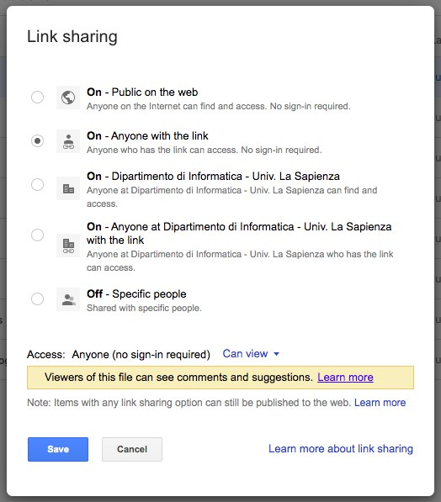
Submission instructions
Homework 2 - Aspect-Based Sentiment Analysis
Upload the zip on your institutional Drive and make it link-shareable and public to anyone (an automatic script will download it).
Make sure it is accessible via an incognito page of your browser!
Do NOT modify the folder structure
You have to submit the homework through the submission form on Google Classroom. You will be asked to fill a form with the requested information and the link to the zip you uploaded on Drive.

Slide 32
Evaluation
How your work will be evaluated
Homework 2 - Aspect-Based Sentiment Analysis

Slide 33
Evaluation Overview
Homework 2 - Aspect-Based Sentiment Analysis
WRITTEN REPORT
18 points
CODE QUALITY
6 points
TOTAL: 36/30 POINTS
QUANTITATIVE RESULTS
6 points
EXTRAS
6 points

Slide 34
Report: dos and don’ts
Homework 2 - Aspect-Based Sentiment Analysis
ACL 2021 paper template
Available here (Word and LaTeX direct download) or here (Overleaf LaTeX template)
You can use either the LaTeX or the Word template, your choice
DO NOT MODIFY the template (margins, spacing, font size)
Use the non-anonymous flag, so you can enter your name
Max 3 pages
For the report, including title, subtitles, etc.
This is a STRICT RULE!
Unlimited extra pages for images, tables and references
Every image and table must have a caption (don’t abuse them please :-) )
Tables and images must be referenced in the report

Slide 35
Report: what you are expected to do
Homework 2 - Aspect-Based Sentiment Analysis
We expect a good report to be:
Readable and understandable
We will not give penalties for English errors, but we expect the report to follow a clear flow. We don’t want to read just a sequence of statements on what you did without showing the reasoning behind your choices
Well-structured and organized
Take inspiration from the many papers available online and organize your report in well-defined sections (e.g. method, setup, experiments, results…)

Slide 36
Report: what you are not expected to do
Homework 2 - Aspect-Based Sentiment Analysis
We expect a good report NOT to include:
Unnecessary task or dataset descriptions
just focus on your solution to the problem.
Code copy-paste
Your code should be self-explanatory, so no need to show it in the report. You can add pseudo-code to show some particular algorithm, but no code or screenshots please!

Slide 37
Report: what you are not expected to do
Homework 2 - Aspect-Based Sentiment Analysis
We expect a good report NOT to include:
Unnecessary low-level implementation details
Avoid any low-level implementation/technical details like “I used a dictionary to store these values”, “I had to use configuration X to solve this exception”, “I could not use Y because there was a dependency issue with Z”, etc.
Instead, we are interested in high-level abstractions/strategies you decide to use to tackle the homework, as well as the intuitions behind your choices.
E.g. use and description of a particular model, explanation of how and why an architecture works, etc.

Slide 38
Code and code Quality
Homework 2 - Aspect-Based Sentiment Analysis
Your project should conform to the following rules:
You MUST use PyTorch.
TensorFlow and other deep learning frameworks are NOT allowed.
PyTorch Lightning MUST be used as high level abstraction to train your model/s.
HuggingFace Transformers and torchtext are now allowed
Frameworks that use PyTorch (e.g. AllenNLP, etc.) are NOT allowed.
Libraries (such as tqdm, sklearn, NLTK) are fine, but since the line between a framework and a library is sometimes blurred, please ask in the Google Classroom group before using any external library: any other library MUST be agreed with the TAs.

Slide 39
Code and code Quality
Homework 2 - Aspect-Based Sentiment Analysis
Your project should conform to the following rules:
You are now allowed to use tools/architectures that have been explained in the class, e.g.:
word embeddings (Word2Vec, GloVe, etc.) are allowed,
contextualized word embeddings (ELMo, etc.) are allowed,
Transformer-based models (BERT, BART, RoBERTa, XLM, etc.) are allowed.
For any doubt, please ask the TAs on Google Classroom.
Comment your code, please!

Slide 40
Baselines
Homework 2 - Aspect-Based Sentiment Analysis
We will evaluate the performance of your model/s on a SECRET test set.
To consider your submission, you must at least reach:
25% (Macro F1-score) for task a
30% (Macro F1-score) for task b
Otherwise, it will be considered FAIL.

Slide 41
Baselines (Extra!)
Homework 2 - Aspect-Based Sentiment Analysis
We will evaluate the performance of your model/s on a SECRET test set.
To consider the extra part in your submission, you must at least reach:
75% (Macro F1-score) for tasks c + d
Otherwise, it will not be considered for extra points.

Slide 42
Quantitative Results
Homework 2 - Aspect-Based Sentiment Analysis
We will evaluate the performance of your model on a SECRET test set.
The overall score considered for evaluation is the one of tasks a + b
You can get from 0 to 6 points according to the following thresholds:
P < 0.30 => 0
0.30 < P < 0.35 => 1
0.35 < P < T3 => 2
T3 < P < T4 => 3
T4 < P < T5 => 4
T5 < P < T6 => 5
P > T6 => 6
Thresholds will be defined based on an internal reference model and the normalized distribution of YOUR scores!

Slide 43
Extras
Homework 2 - Aspect-Based Sentiment Analysis
You can achieve up to 6 points with some extras!
An “extra” is whatever you decide to add to your model to make it better. For instance:
implement parts c + d of the ABSA pipeline,
use of pre-trained embeddings,
use of NLP best practices,
comparative analysis of results in your report,
informative plots in your report,
new ideas (including using external resources in a clever way, please see slide X)
and more, according to internal baselines. Don’t forget to explain your choices in the report! Extras that are not explained in the report will not be considered for evaluation.

Slide 44
Evaluation
Homework 2 - Aspect-Based Sentiment Analysis
test.sh is identical to what we will be using
If it does not run on your side, we will not correct your homework
Note that, if you use any kind of hard-coded paths, this script won’t work
Use paths relative to the project root folder, e.g.:
NO: /home/pincopallino/my_folder/model/weights.th
OK: model/weights.th

Slide 45
Warnings
Things you should be aware of
Homework 2 - Aspect-Based Sentiment Analysis

Slide 46
Please be aware that
Homework 2 - Aspect-Based Sentiment Analysis
This is an individual homework! Collaboration among the students is not allowed.
We will check for plagiarism both manually and automatically.
It is not allowed to:
Copy from other students
Share your code with other students
Copy from online resources (StackOverflow, GitHub, Medium and so on).
However, you are allowed to use material from external sources as long as it is not central to the homework.
In this case, it is MANDATORY to cite such resources in the report

Slide 47
Please be aware that
Homework 2 - Aspect-Based Sentiment Analysis
If we find out that you breached any of the above rules, you will automatically FAIL this homework and you will have to pass a FULL EXAM.
Plagiarism will imply further consequences at the Faculty level.
While we release the homework on GitHub, DO NOT FORK THE PROJECT.
If you want to continue using GitHub for versioning, clone the project and re-upload it.
If we realize you shared your code in any way (forking or otherwise), even without the intention of letting others copy, you will be failed automatically.

Slide 48
Use of external data
Homework 2 - Aspect-Based Sentiment Analysis
For your experiments, use the provided data (train and dev) in the data folder; use each file as defined in the standard ML conventions (train for training, dev for model selection).
Use only the training set to train the model that you submit for evaluation. If you train it on more data (dev set or any other external data), it will be a FAIL.
You can use external resources (E.g. BabelNet, etc.); if you have doubts, please ask on the Google Classroom.

Slide 49
Tips
Homework 2 - Aspect-Based Sentiment Analysis

Slide 50
A few tips to organize your work:
Homework 2 - Aspect-Based Sentiment Analysis
Start as soon as possible!
Training a neural network requires time, possibly hours, depending on your hardware
Don’t wait until last day to test the submitting code!!!!
Start small!
If you don’t get decent results with a very very simple neural network, there is a good chance that adding other things won’t make your model perform better
Leave the “extras” as the last thing!
Leave some time for hyperparameter tuning!
Sometimes good hyperparameter combinations can do wonders for your neural network
Use Google Colab (free GPUs!)

Slide 51
Deadline
When to deliver what
Homework 2 - Aspect-Based Sentiment Analysis

Slide 52
Deadline
Homework 2 - Aspect-Based Sentiment Analysis
Submission date: June 15th, 2021
23:59:59 Italian time (UTC + 1)
Submit the homework through the submission form on Google Classroom. You have to fill the form with the requested information and a link to the zip folder of the homework on Google Drive.

Slide 53
Awards
Get a Sapienza NLP™ t-shirt
Homework 2 - Aspect-Based Sentiment Analysis

Slide 54


Win a Sapienza NLP t-shirt!
Homework 2 - Aspect-Based Sentiment Analysis
We will hand out amazing Sapienza NLP t-shirts to the overall top-5 students!
The final ranking will be computed according to the scores on our secret test set.

Slide 55
That’s not all
Homework 2 - Aspect-Based Sentiment Analysis
If your work is novel, interesting and original, we will gladly invite you to work together with us to extended on a fully-fledged paper for TOP-TIER INTERNATIONAL CONFERENCE!
Just over the last 12 months, the Sapienza NLP group published more than a dozen of papers!

Slide 56
Questions?
Homework 2 - Aspect-Based Sentiment Analysis
If you have a question that may interest your colleagues, please ask it on Google Classroom.
Otherwise, for personal or other questions, send an email to ALL of us (but please, only reach for things that can’t be asked on the Google Classroom).
Our emails are:
campagnano@di.uniroma1.it
huguetcabot@babelscape.com

